Slide 1
Data science from a topological viewpoint
曹越琦（Yueqi Cao）
Beijing institute of technology
Notes:
My report is about data science from a topological viewpoint. In this report I’ll talk about our latest progress on computation of high dimensional persistence. We’ll also introduce some topological methods in manifold learning.

Slide 2
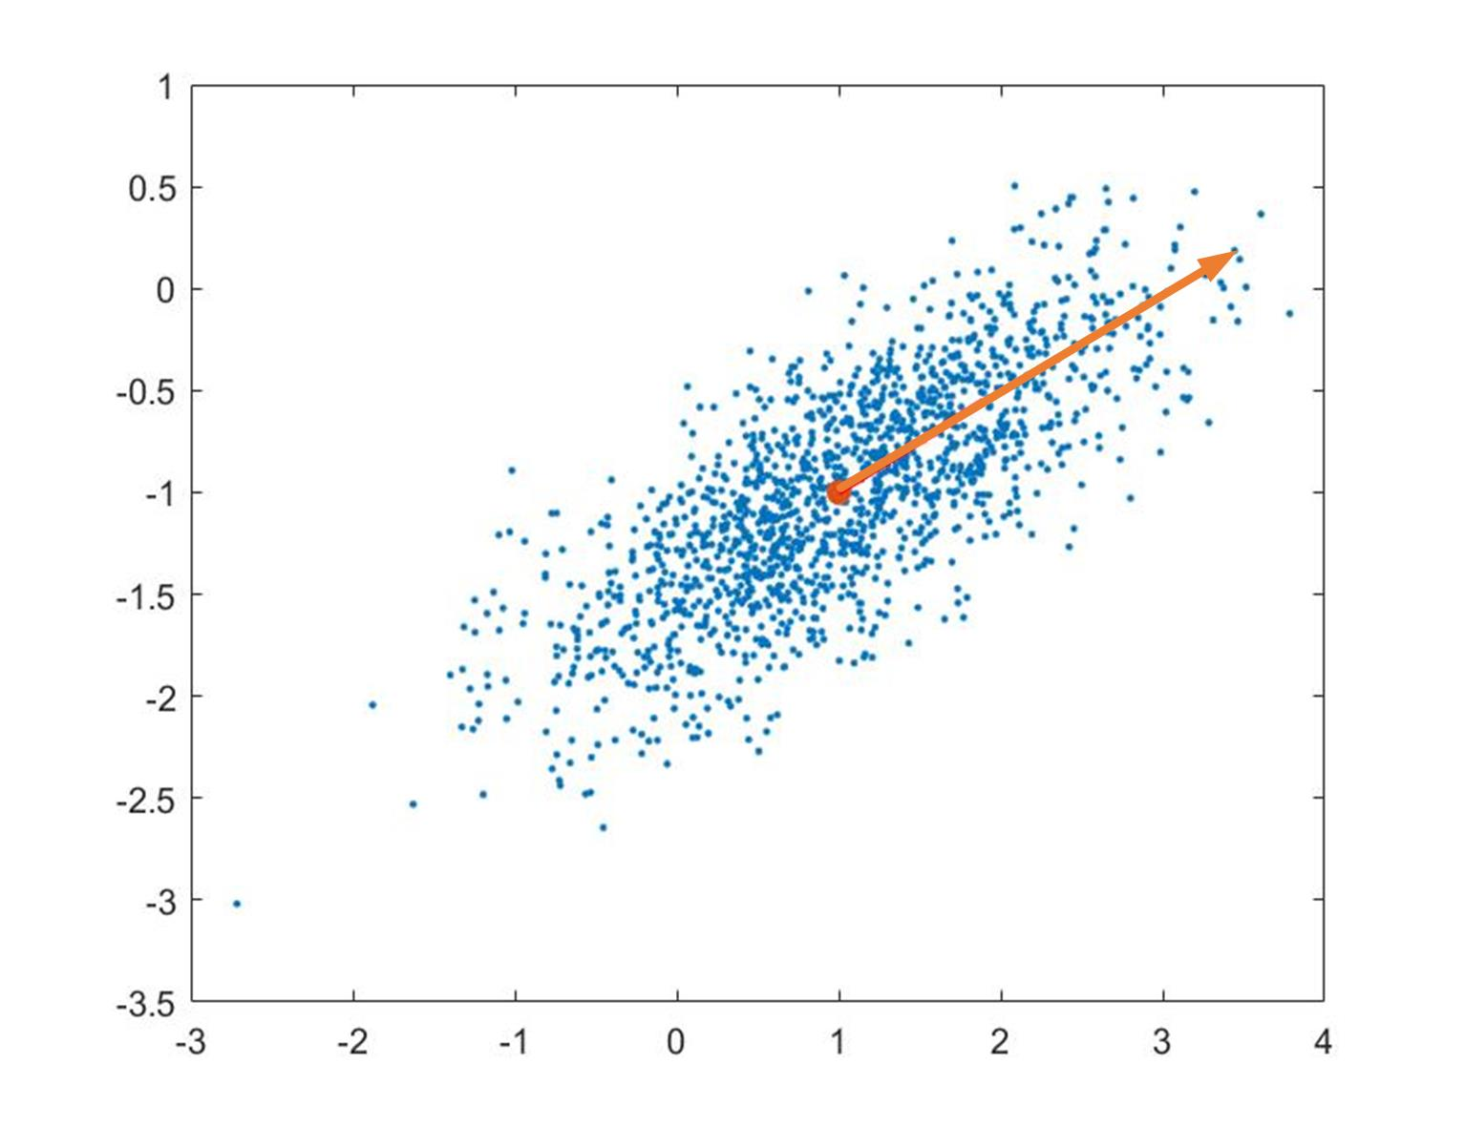
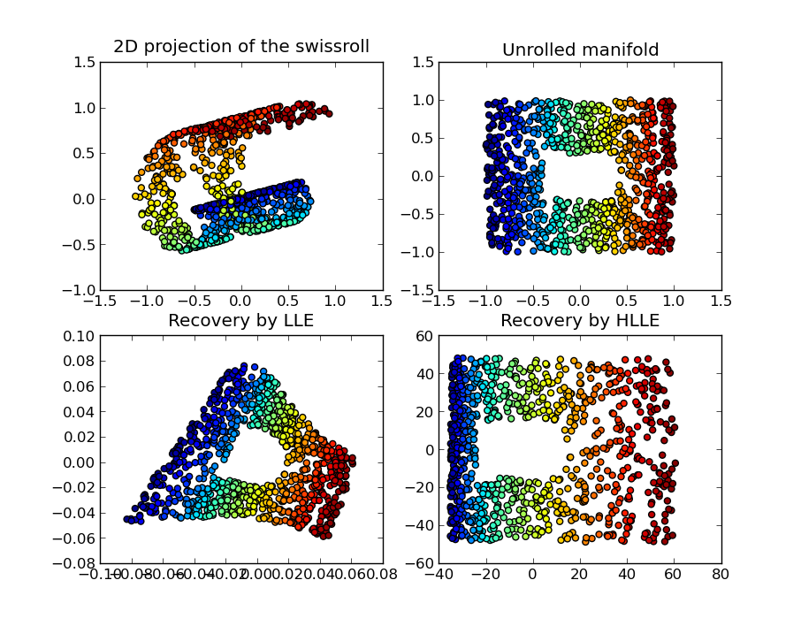
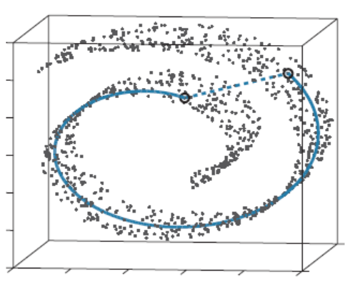
PCA
LLE/Hessian LLE
Source:https://en.wikipedia.org/wiki/Nonlinear_dimensionality_reduction#Hessian_Locally-Linear_Embedding_(Hessian_LLE)
Isomap
Notes:
In traditional data science, people were working with data with special structures. For example, principle component analysis (PCA for short) assumes the data set lies on a linear subspace. If the intrinsic space is a nonlinear manifold, PCA doesn’t work well. Isomap assumes the data set lies on a Riemannian manifold. The correlation between two points is reflected by their geodesic distance. Local linear embedding (LLE for short) assumes the local linear structure of data, so that the all information is contained in the coefficient matrix.

Slide 3
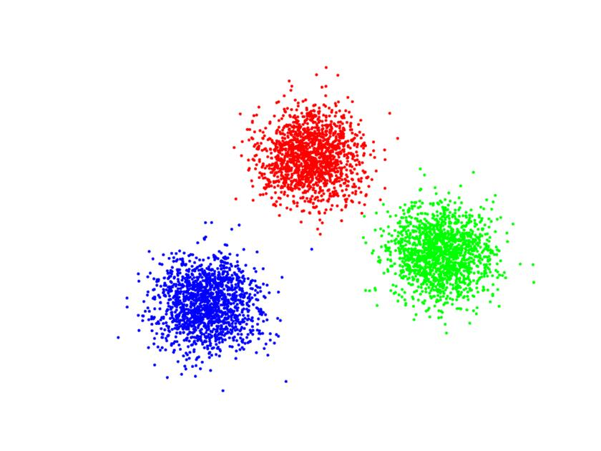
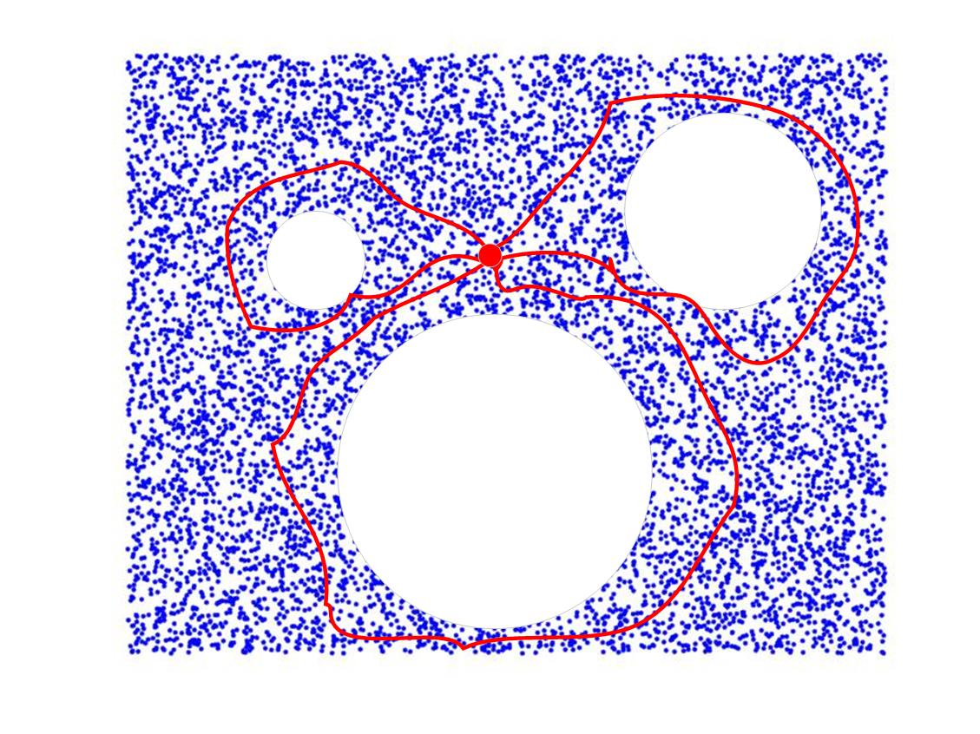
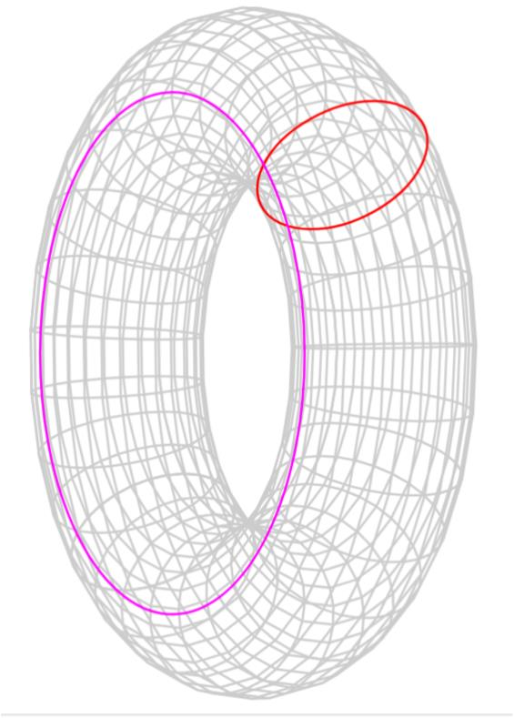
Topology
Connected components
Holes
Tunnels
Notes:
However, topology is a much more general structure than linearity and metric. In topology you only figure out the ‘neighborhoods’ of each data. But what you obtain are the global features about data sets. Topological invariants imply the connectivity in all dimensions. For example, in dimension 0 it implies the number of connected components. In dimension 1 it implies the number of holes. In dimension 2 it implies the number of tunnels.

Slide 4
Topological data analysis
……
Source: Hamid R. Eghbalnia, the practice of topological estimation
Notes:
The main idea about topological data analysis is that, we try to find the homology classes which are stable during the variation of parameters. To get some intuition let’s look at this picture. This picture is copied from the Prof. Hamid’s ppt. The parameter is the radius of each solid ball. When the radius is small each data is isolated so that we won’t have any useful information. As the radius increase, the solid balls overlap and the union approximates the intrinsic space. At this stage the information comes to its maximum. After that the solid balls merge as one so that the information decreases. However, the critical period will last for a long time, and the homology classes which persist will imply the true topology of intrinsic space.

Slide 5
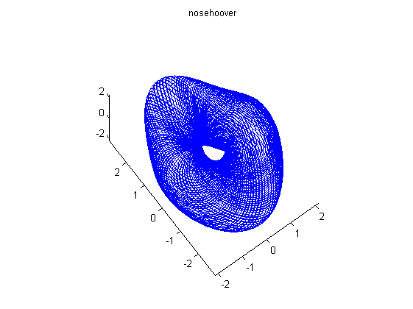
Chaos & Topology
Notes:
TDA has many applications. Here we introduce one application in chaos theory. Given a chaos system, usually we don’t know the topology of its strange attractor. By computing the persistent homology of its orbits, we may know the topology about the strange attractor. For example, this is a chaos system simplified from a physical model. On the left is the orbit starting from an initial point.

Slide 6
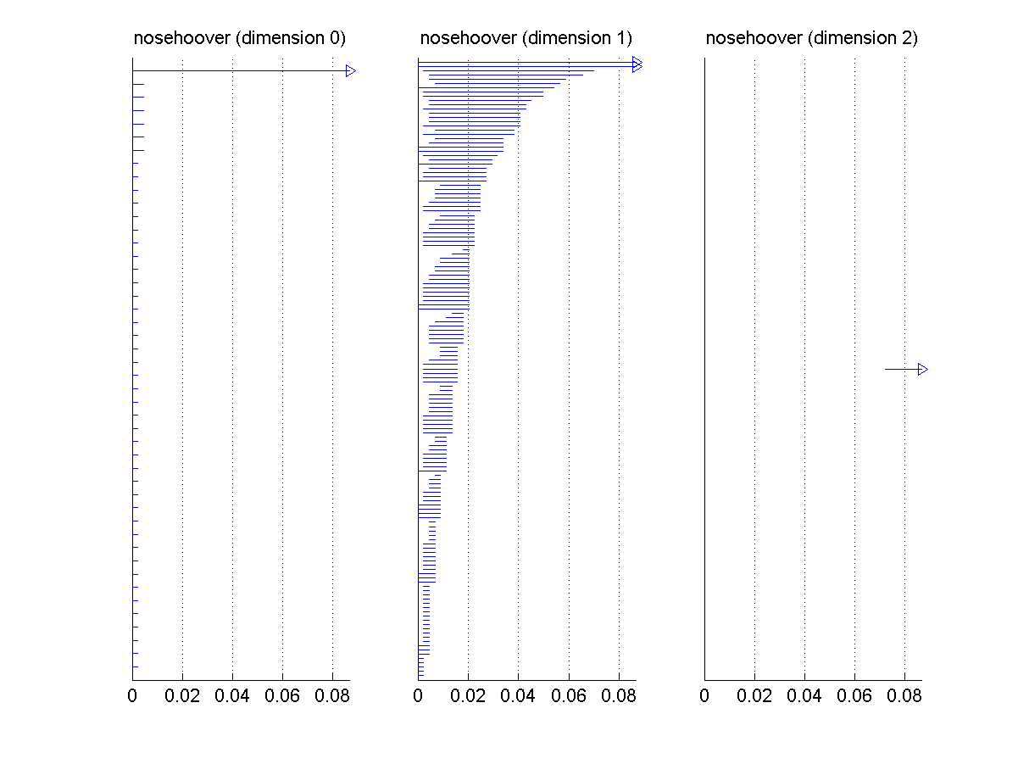
Notes:
This persistence diagram shows that the strange attractor is a torus. There is an arrow in 0 dimension, two arrows in 1 dimension, and one arrow in 2 dimension. According to the classification of 2-surfaces, it’s a torus. We’ll explain this picture later.

Slide 7
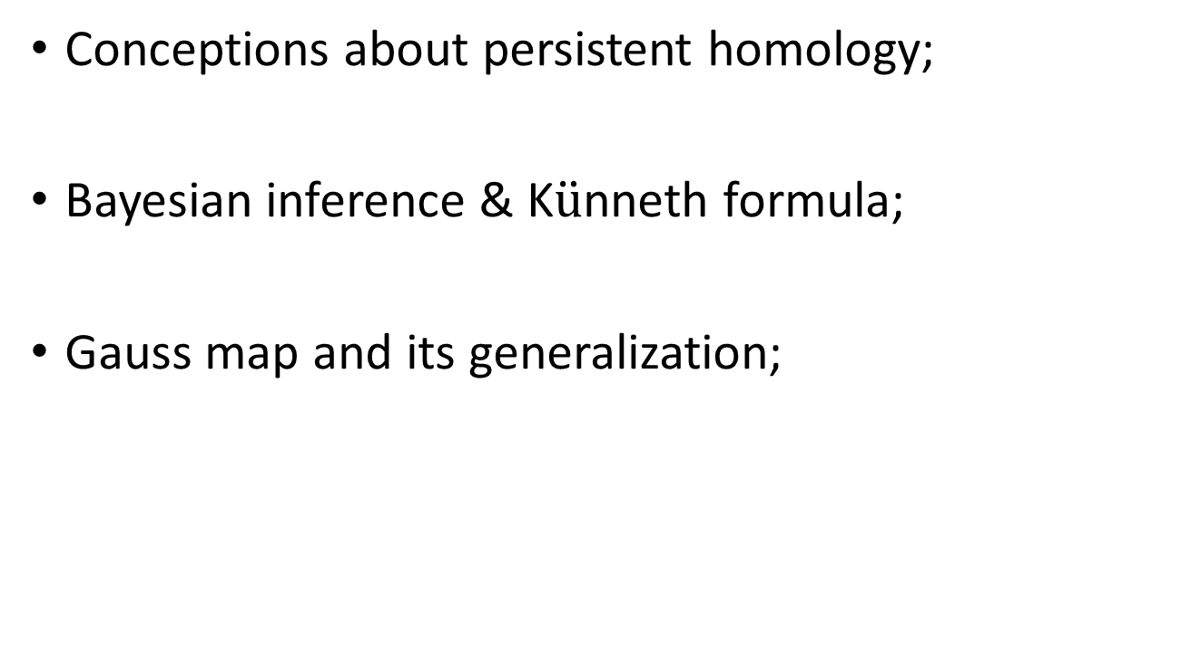
Outlines
Conceptions about persistent homology;
Bayesian inference & K$\ddot{u}$nneth formula;
Gauss map and its generalization;
Notes:
Our report consists of three sections. First we talk about some conceptions about persistent homology. Then we show how we can use Bayesian inference and kunneth formula to compute high dimensional persistence. Finally we talk about the application of gaussian spherical map in the computation of curvature and topological data analysis.

Slide 8
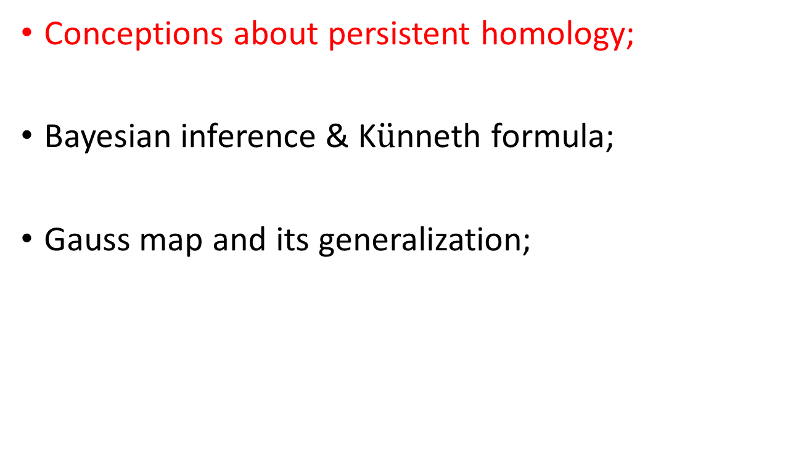
Outlines
Conceptions about persistent homology;
Bayesian inference & K$\ddot{u}$nneth formula;
Gauss map and its generalization;

Slide 9
Simplical complexes & simplicial homology
Simplices : convex hulls of points in general positions
Point
Line segment
triangle
Tetrahedron
Notes:
Let’s recall some definitions about simplicial complexes and simplicial homology. A n dimensional simplex is a convex hull of n+1 points in general position. For example, a 0-dim simplex is a point, 1-dim simplex is a line segment, 2-dim simplex is a triangle, and a 3-dim simplex is a tetrahedron.

Slide 10
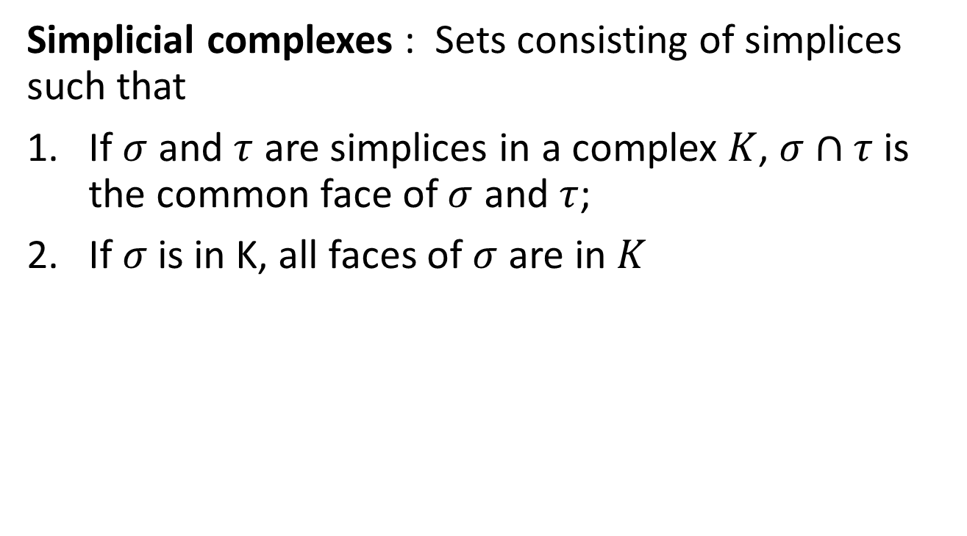
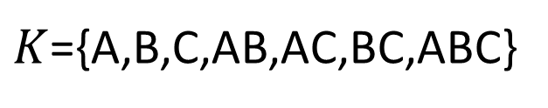
Simplicial complexes & simplicial homology
Simplicial complexes : Sets consisting of simplices such that
If $σ$ and $τ$ are simplices in a complex $K$, $σ∩τ$ is the common face of $σ$ and $τ$;
If $σ$is in K, all faces of $σ$ are in $K$
A
$K$={A,B,C,AB,AC,BC,ABC}
B
C
Notes:
A simplicial complex is a combination of simplices. The combination is such that

Slide 11
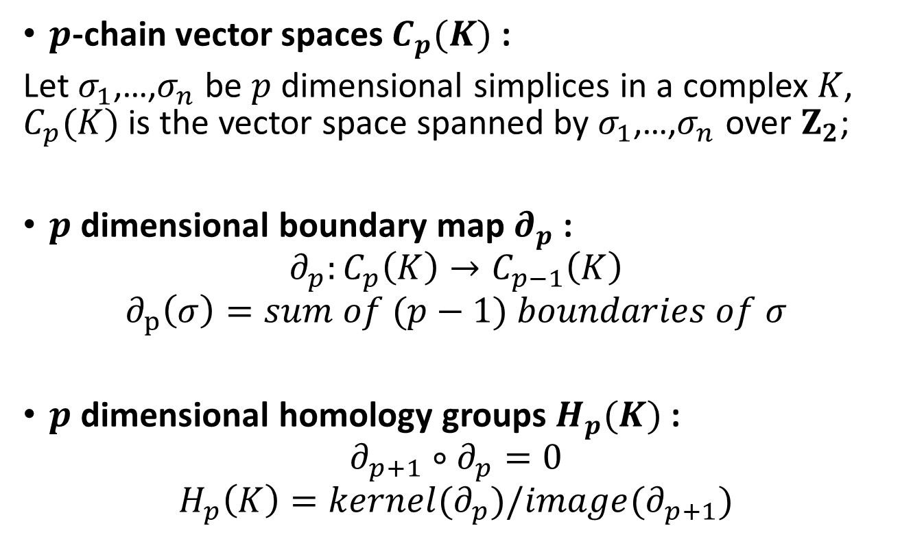
Simplicial complexes & simplicial homology
$p$-chain vector spaces $C_{p}(K)$ :
Let $σ_{1}$,…,$σ_{n}$ be $p$ dimensional simplices in a complex $K$, $C_{p}(K)$ is the vector space spanned by $σ_{1}$,…,$σ_{n}$ over $Z_{2}$;
$p$ dimensional boundary map $∂_{p}$ :
$$∂_{p}:C_{p}\left(K\right)→C_{p−1}\left(K\right)$$
$$∂_{p}\left(σ\right)=sum of (p−1) boundaries of σ$$
$p$ dimensional homology groups $H_{p}(K)$ :
$$∂_{p+1}∘∂_{p}=0$$
$$H_{p}\left(K\right)=kernel(∂_{p})/image(∂_{p+1})$$
Notes:
The p-chain vector space is spanned by p-dim simplices over z2. here we use z2 for simplicity. Z2 can be replaced by any abelian group. The p-boundary map is defined such that it takes each p-simplex to its p-1 boundaries. The boundary of a boundary is zero. So the p-homology vector space is defined as the quotient space of kernel partial p and image partial p+1

Slide 12
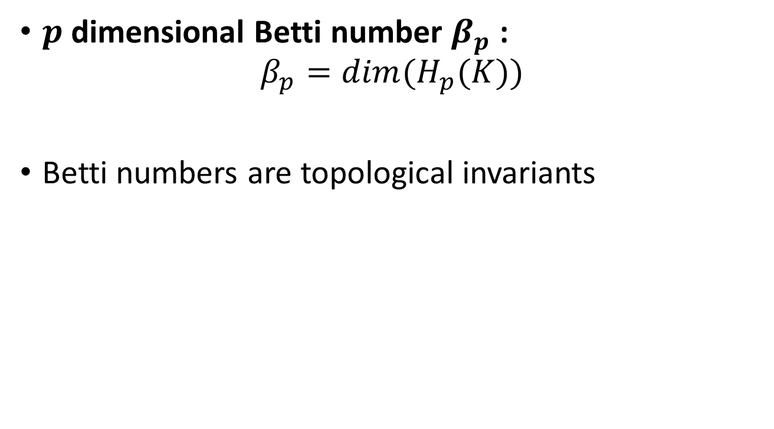
Simplicial complexes & simplicial homology
$p$dimensional Betti number $β_{p}$ :
$$β_{p}=dim(H_{p}(K))$$
Betti numbers are topological invariants
Notes:
The dimension of p homology vector space is called p-betti number. Betti numbers are important topological invariants. For example, 2-surfaces are totally determined by their betti numbers.

Slide 13
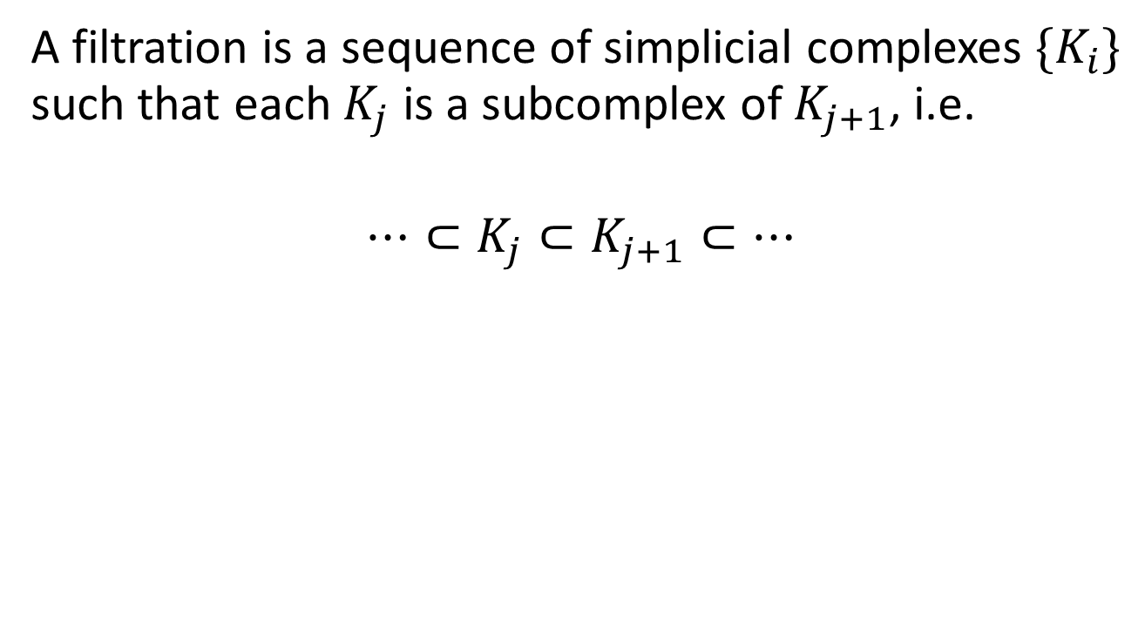
Filtrations
A filtration is a sequence of simplicial complexes $\{K_{i}\}$ such that each $K_{j}$ is a subcomplex of $K_{j+1}$, i.e.
$$⋯⊂K_{j}⊂K_{j+1}⊂⋯$$
Notes:
A very important definition in persistent homology is filtration. A filtration is, informally, the expansion or growth of simplicial complexes.

Slide 14
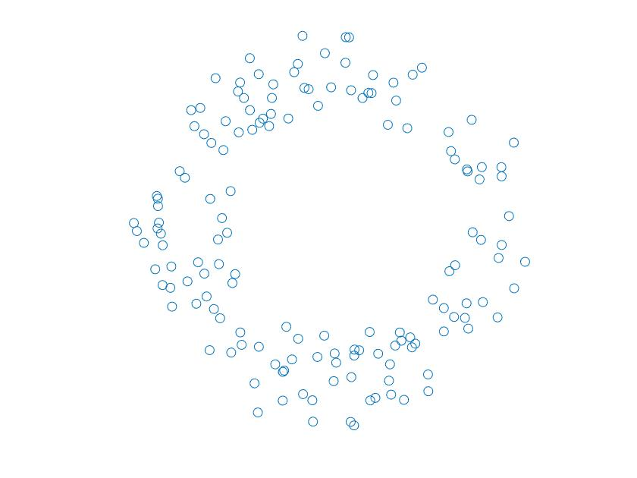
Notes:
Let’s see an example about filtration. These are 100 points from a noisy circle. The following cartoon will show you a filtration of simplicial complexes.

Slide 15


Slide 16
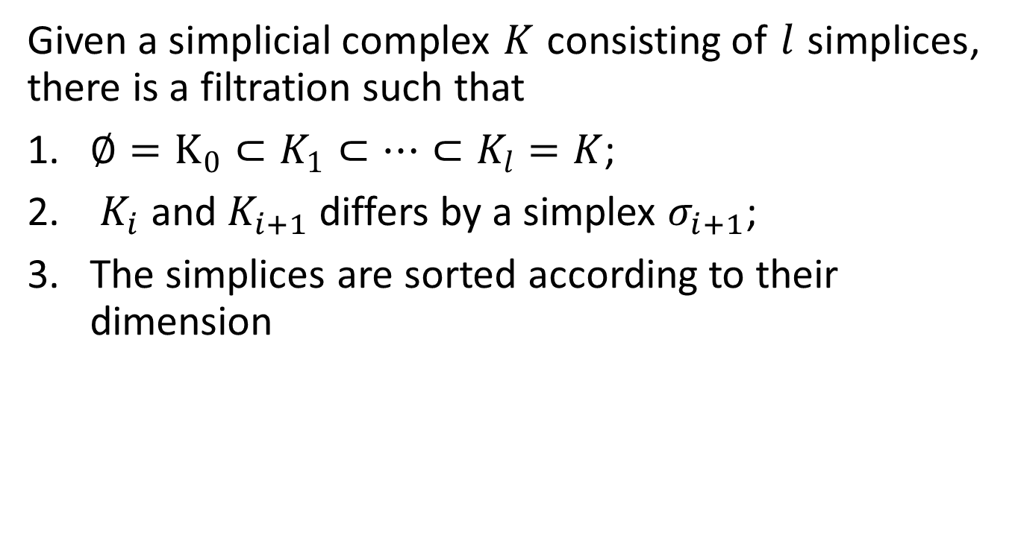
Elementary filtration
Given a simplicial complex $K$ consisting of $l$ simplices, there is a filtration such that
$∅=K_{0}⊂K_{1}⊂⋯⊂K_{l}=K$;
$K_{i}$ and $K_{i+1}$ differs by a simplex $σ_{i+1}$;
The simplices are sorted according to their dimension
Notes:
A special kind of filtration is that you add exactly one simplex at each time. This is possible given any simplicial complex. We call it elementary filtration.

Slide 17

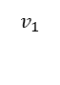
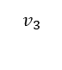
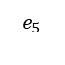
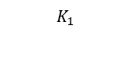
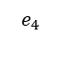

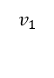
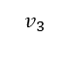
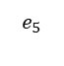
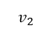
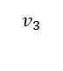
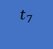


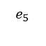

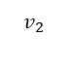
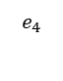
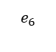
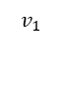
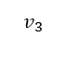

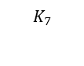
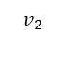
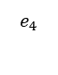
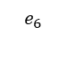
$$v_{1}$$
$$v_{1}$$
$$v_{1}$$
$$v_{2}$$
$$v_{2}$$
$$v_{3}$$
$$K_{1}$$
$$K_{2}$$
$$K_{3}$$
$$v_{1}$$
$$v_{1}$$
$$v_{1}$$
$$e_{4}$$
$$e_{4}$$
$$e_{4}$$
$$e_{6}$$
$$e_{5}$$
$$e_{5}$$
$$v_{2}$$
$$K_{4}$$
$$v_{3}$$
$$v_{2}$$
$$K_{5}$$
$$v_{3}$$
$$v_{2}$$
$$v_{3}$$
$$K_{6}$$
$$v_{1}$$
$$e_{4}$$
$$e_{6}$$
$$t_{7}$$
$$v_{2}$$
$$v_{3}$$
$$e_{5}$$
$$K_{7}$$
Notes:
For example this is an elementary filtration of a triangle. We first place vertices, and then edges, and finally add the triangle.

Slide 18
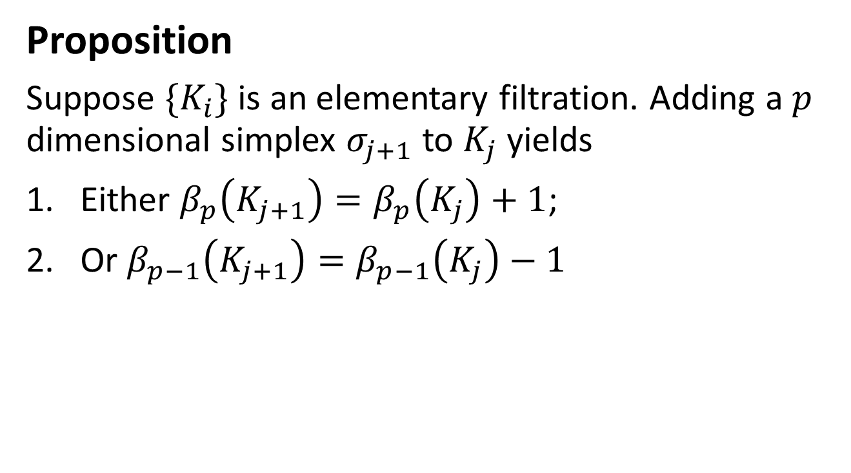
Elementary filtration
Proposition
Suppose $\{K_{i}\}$ is an elementary filtration. Adding a $p$ dimensional simplex $σ_{j+1}$ to $K_{j}$ yields
Either $β_{p}\left(K_{j+1}\right)=β_{p}\left(K_{j}\right)+1$;
Or $β_{p−1}\left(K_{j+1}\right)=β_{p−1}\left(K_{j}\right)−1$
Notes:
An important fact about elementary filtration is that adding one simplex will cause one of the following two results: you either kill an old cycle or generate a new cycle. Passing to betti numbers we have the formal statement: either p dim betti number increase by one or p-1 dim betti number decrease by one

Slide 19
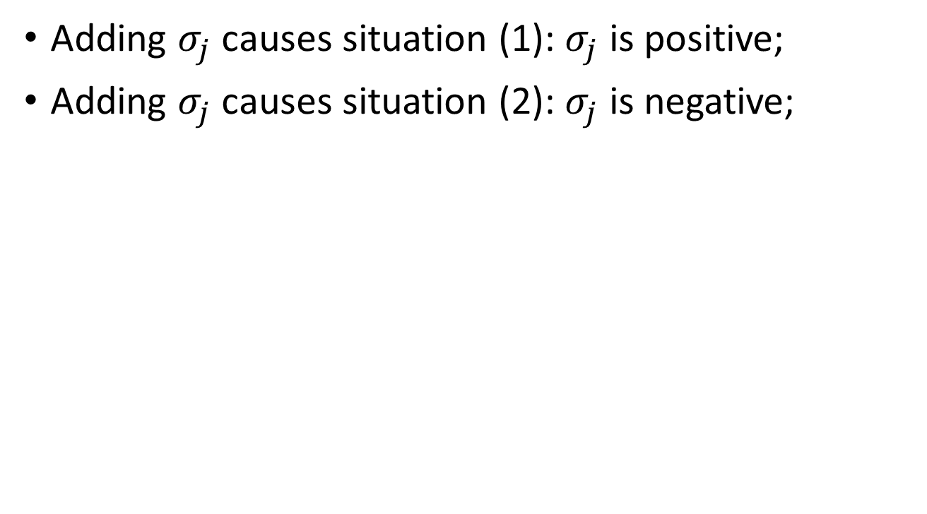
Pairing
Adding $σ_{j}$ causes situation (1): $σ_{j}$ is positive;
Adding $σ_{j}$ causes situation (2): $σ_{j}$ is negative;
Notes:
If adding sigma generate a new cycle we say it’s positive; if adding sigma kills an old cycle we say it’s negative

Slide 20
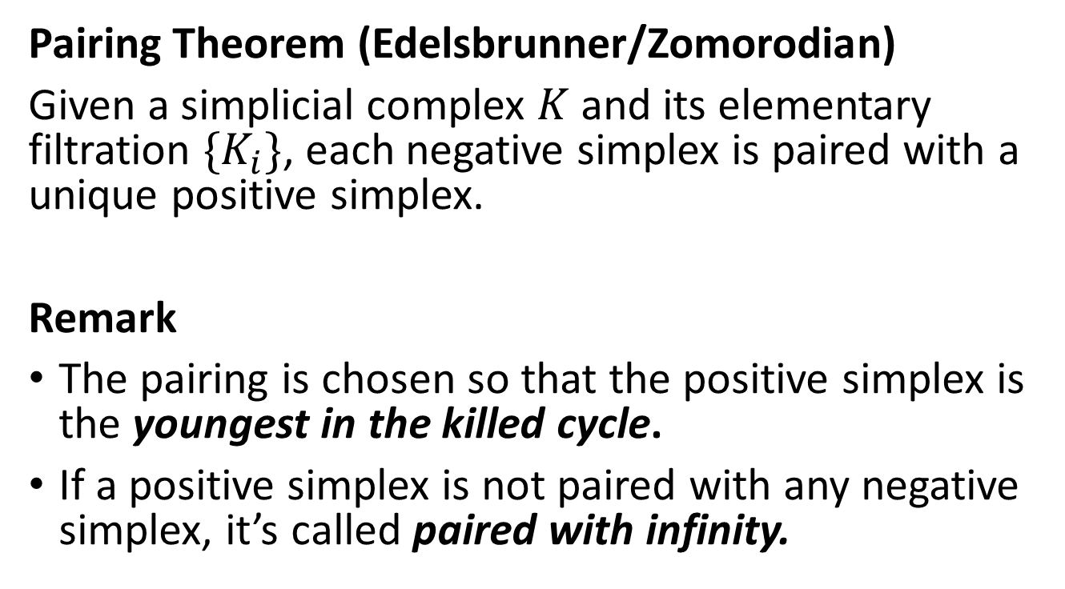
Pairing
Pairing Theorem (Edelsbrunner/Zomorodian)
Given a simplicial complex $K$ and its elementary filtration $\{K_{i}\}$, each negative simplex is paired with a unique positive simplex.
Remark
The pairing is chosen so that the positive simplex is the youngest in the killed cycle.
If a positive simplex is not paired with any negative simplex, it’s called paired with infinity.
Notes:
A fundamental theorem states that in an elementary filtration, each negative simplex is paired with a unique positive simplex. This theorem is proved by the creators of persistent homology. In particular, this pairing is constructive. It is chosen so that the positive simplex is the youngest in the killed cycle. ‘youngest’ means that the order is the largest among simplices in the closed cycle. This theorem enables the creators to find out an algorithm to compute pairing. Until now this algorithm is one of the most efficient in practice.
We also note that this theorem doesn’t assert that each positive simplex is paired with a negative simplex. In fact, if a positive simplex is not paired with a negative simplex, it’s called paired with infinity.

Slide 21

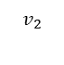
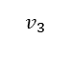
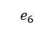
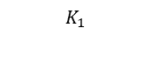
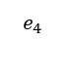

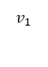
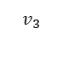
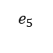
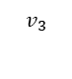















$$v_{1}$$
$$v_{1}$$
$$v_{1}$$
$$v_{2}$$
$$v_{2}$$
$$v_{3}$$
$$K_{1}$$
$$K_{2}$$
$$K_{3}$$
$$v_{1}$$
$$v_{1}$$
$$v_{1}$$
$$e_{4}$$
$$e_{4}$$
$$e_{4}$$
$$e_{6}$$
$$e_{5}$$
$$e_{5}$$
$$v_{2}$$
$$K_{4}$$
$$v_{3}$$
$$v_{2}$$
$$K_{5}$$
$$v_{3}$$
$$v_{2}$$
$$v_{3}$$
$$K_{6}$$
$$v_{1}$$
$$e_{4}$$
$$e_{6}$$
$$t_{7}$$
$$v_{2}$$
$$v_{3}$$
$$e_{5}$$
$$K_{7}$$
Notes:
Let’s see the elementary filtration of a triangle. Each vertex is positive because adding a vertex will increase a connected component. Orange edges are negative because they decrease the connected components. Blue edge is positive because it forms a closed cycle. The closed cycle is killed by the orange triangle so that the orange triangle is negative. The pairing is chosen that e4 is paired with v2 because v2 is the youngest in the boundary of e4. similarly e5 is paired with v3. t7 is paired with e6.

Slide 22

Barcodes
Given an arbitrary filtration $\{L_{i}\}$,
$$∅=L_{0}⊂L_{1}⊂⋯⊂L_{n}$$
Suppose $σ_{j}$ and $τ_{k}$ is a pair of simplices. Let $t_{i},$ $t_{k}∈\{1,2,…,n\}$ be the time $σ_{j}$ and $τ_{k}$ entering the filtration. The open and closed interval $[t_{i},t_{k})$ is called a barcode.
If $η$ is a positive simplex paired with infinity, $t_{k}=∞$
Notes:
Now if you are given an arbitrary filtration, you can construct an elementary filtration and do pairing. Each paired simplices correspond to an open and closed interval, where the endpoints of the interval record the time simplex entering the filtration. The intervals are called barcodes. The diagram of barcodes is called persistence diagram.

Slide 23
Barcodes
Long barcodes imply the true homology
Short barcode are topological noises
Notes:
Long barcodes mean the homology classes are stable, which carry the topological information about data. Short barcodes mean the homology classes quickly disappear, which are noises contained in data.

Slide 25
Barcodes
Barcodes are invariants of a filtration
Reference: G.Carlsson, A.Zomorodian Computing Persistent Homology
Notes:
Another important fact about barcodes is that they are invariants of a filtration. This is explained by prof. carlsson in the language of commutative algebra. We won’t talk about this in the report.

Slide 26

Nerves
Let $F=\{U_{1},U_{2},⋯,U_{n}\}$ be a finite cover of space $M$. A $k$-simplex is spanned by $k+1$ elements in $F$ if the $(k+1)$-intersection of these sets is not empty. i.e.
$$Nerve of F≔\{U⊂F|∩U≠∅\}$$
Notes:
I haven’t told you how to make a filtration from a discrete data set. The idea is to use nerves. If you have a finite cover of a space, then you can make a simplicial complex by taking the intersection of covers. More precisely , a k-simplex….

Slide 27

Čech complexes
Let $X$ be a data set, $r>0$ be a positive number. The closed balls centered at each data $X_{i}$ with radius r give a cover $F$ of $X$. The nerve of $F$ is a simplicial complex, called Čech complex.
Notes:
For example, around each data you take a ball of radius r. the nerve of these balls is a simplicial complex. It’s called cech complex.

Slide 28











$$u_{1}$$
$$u_{4}$$
$$u_{1}$$
$$u_{2}$$
$$u_{5}$$
$$u_{2}$$
$$u_{5}$$
$$u_{3}$$
$$u_{4}$$
$$u_{3}$$
An open cover of $S^{1}$
Čech complex of the open cover
Notes:
This is a picture of cech complex. Each ball denote a vertex in the cech complex. Each edge means two balls intersect once.

Slide 29

Complexity
Suppose the data set $X$ consists of $N$ points. The space complexity (number of simplices) of Čech complex is $2^{N}$ (in worst case);
The time complexity of pairing algorithm is ${\left|K\right|}^{3}$, where $|K|$ is the number of simplices in $K$.
Notes:
There are many ways to construct filtration. We won’t talk further. Let’s consider the complexity of the algorithm. Suppose…

Slide 30

Outlines
Conceptions about persistent homology;
Bayesian inference & K$\ddot{u}$nneth formula;
Gauss map and its generalization;

Slide 31
Present situation
Many ideas are proposed to simplify the construction of filtrations and accelerate the pairing algorithm.
The computation of persistence stays in a level of 0, 1 and 2 dimensions.
Chaos systems in high dimensions
Notes:
So….I want to explain the present situation about persistent homology. Many ideas are proposed to simplify the construction of filtrations and accelerate the pairing algorithm. But the computation of persistence stays in a level of 0th, 1st and 2nd dimension. In most cases these are enough for our study. For example when we do clustering we only need 0th persistence. But in some cases persistence in high dimensions are also important. For example when we want to know the topology of high dimensional strange attractors of chaos systems. We need to compute the high dimensional persistence.

Slide 32
Present situation
A general algorithm for computations in high dimensions is NOT EASY!
Data sets with additional structures
Notes:
However, coming up with a general algorithm is not easy. The greatest obstacle is complexity. If we want to know the high dimensional persistence, our best hope is that the data set has special structures. Here we consider the independence structure of data sets and we show this corresponds to a special class of spaces.

Slide 33

Independence
Suppose $Z$ and $W$ are independent random vectors.
$$f\left(z,w\right)=f_{1}\left(z\right)f_{2}(w)$$
Notes:
Suppose z and w are independent random vectors, which means their joint density function is the product of marginal density functions. In geometry we may think of z and w as two independent axes. And each event is a point in the plane spanned by z and w.

Slide 34


Product spaces
If $M⊂R^{l}$ and $N⊂R^{d}$, the product space $M×N$ is a subspace of $R^{l+d}$
Notes:
This leads us to think about spaces with product structure. If m is a subspace of rl…

Slide 35

Hypothesis
Suppose data set $X$ is sampled from a random vector $X=(Z,W)$, where $Z$ is $l$ dimensional and $W$ is $d$ dimensional and they are independent.
The intrinsic space of $X$ is the product of $M⊂R^{l}$ and $N⊂R^{d}$.
Notes:
Therefore we propose the following hypothesis. Suppose….. The problem divides into two direction: one is how to infer the independence structure, the other is how to compute the homology of product spaces

Slide 36


K$\ddot{u}$nneth formula
Suppose $M$ and $N$ are two topological spaces. The (singular) homology of $M×N$ (with $Z_{2}$ coefficients) is such that
$$H_{n}\left(M×N\right)≅⊕_{i+j=n}(H_{i}\left(M\right)⊗H_{j}\left(N\right))$$
Notes:
The second question is answered by kunneth formula. Kunneth formula is proposed in the last century and it shows that the homology of the product space is the direct sum of tensor products by the homology of factor spaces. Here coefficient group is important. If you use other abelian groups as coefficients the formula is different and looks more complex.

Slide 37

Bayesian inference
Suppose $X∼f(x,θ)$. Let $X$ be a data set (observations) sampled from $X$. Bayes’ theorem asserts
$$P\left(θ | X\right)=\frac{P\left(X | θ\right)P(θ)}{P(X)}∝P\left(X | θ\right)P(θ)$$
$f(x,θ)$: proposal distribution
$P(θ|X)$: posterior distribution
$P(θ)$: prior distribution
$P\left(X | θ\right)$: likelihood function
Notes:
For the first question we confront the classic problem called Bayesian inference. The standard framework of Bayesian inference consists of four parts. First you come up with a proposal distribution of data sets. Then you set a prior distribution on the space of parameters in the proposal distribution. Next you compute the likelihood according to the observations. Finally you know the posterior distribution which is our target. Bayesian inference is a large area in statistics and each step is a studying project. Here we introduce one method called graphical modeling. This one is recommended by prof. sayan in duke university.

Slide 38


Graphical models
Let $X,Y$ and $Z$ be three random variables. $X$ and $Z$ are conditionally independent if
$$p\left(x,z | y\right)=p\left(x | y\right)p(z|y)$$
Notes:
The main idea of graphical modeling is making a graph to represent the conditional independence structure of random variables. Let……

Slide 39


Graphical models
$X$ and $Z$ are conditionally independent; $Y$ and $W$ are conditionally independent

Slide 40

Graphical models
In a complete graph (clique) there are no such conditionally independent random variables

Slide 41

Bayesian inference
Proposal distribution: $X∼N(0,Σ)$
Prior distribution: $P\left(G,Σ\right)=P\left(G\right)P(Σ|G)$
Likelihood: $\int_{SPD(n)}{f\left(x | G,Σ\right)dΣ }$
Posterior distribution:
$P\left(G,Σ | x\right)∝$ $\int_{SPD(n)}{f\left(x | G,Σ\right)P\left(G\right)P(Σ|G)dΣ }$
Notes:
Let’s come back to Bayesian inference. If we want to know the conditional independence structure of a data set, we should compute the posterior probability of each graph. Suppose our proposal distribution is multivariate gaussian. We should figure out the prior distribution for graphs and covariance matrices. Then we compute the likelihood, which is an integration over the space of symmetric positive definite matrices. This integration can be expressed in a closed form so the computation won’t be difficult. The graph with greatest posterior probability is what we need.

Slide 42

Simulation
$T$ is a flat torus embedded in 4-dim Euclidean space $T=S^{1}×S^{1}⊂R^{4}$
Let $α,β$ be two random variables i.i.d Uniform(0,1). Let $x,y,z,w$ be the coordinates. Use the transformation
$$x=\cos\left(2πα\right)$$
$$y=\sin\left(2πα\right)$$
$$z=\cos\left(2πβ\right)$$
$$w=sin⁡(2πβ)$$
Notes:
Let’s see an example. A flat torus is a product of two circles. We sample points by the transformation.

Slide 43


Simulation
Computation of flat torus shows that the four graphs with greatest posterior probability are
Notes:
Going through the framework of bayesian inference, we find that the graph with greatest posterior probability is made by two components. So we project data to its first two coordinates and last two coordinates and compute the persistent homology respectively. The homology of flat torus is known by kunneth formula.

Slide 44

Problems
The space of undirected graphs with $n$ nodes consists of $2^{\frac{n\left(n−1\right)}{2}}$ graphs
Product spaces are special
Generalization: fiber bundles
Notes:
The idea is natural. But there’re also problems. In Bayesian inference of graph models, we should note that the space of graphs is exponential. So actually we cannot compute the posterior probability of each graph, when n is large. In practice we always use heuristic algorithms to compute the optimal result. The second problem is that product spaces are too special. Whenever you have a data set, usually they are not happened to be sampled from a product space. So this method needs generalization. For example, product spaces are trivial fiber bundles. If we can find some connection between statistics and fiber bundles. We can generalize this method to more data sets.

Slide 45

Outlines
Conceptions about persistent homology;
Bayesian inference & K$\ddot{u}$nneth formula;
Gauss map and its generalization;
Notes:
In the third part we talk about the applications of gauss map and its generalization.

Slide 46


Gauss map
Source: https://en.wikipedia.org/wiki/Carl_Friedrich_Gauss
Notes:
Gauss proposed gauss map in his famous paper general investigation of curved surfaces. This paper is the cornerstone in differential geometry. Gauss first wrote a draft on the topic in 1825 and published in 1827

Slide 47


Gauss map
Let $M⊂R^{3}$ be a smooth, orientable surface. Gauss map is defined by
$$g:M→S^{2}$$
$g\left(p\right)$ is the unit normal vector at $p$
Notes:
Gauss map is defined as follows: let…

Slide 48


Gaussian curvature
The gaussian curvature at $p$ is defined by
$$K\left(p\right)=\frac{infinitesimal area at g\left(p\right)}{infinitesimal area at p}=det⁡(dg)$$
Notes:
Using gauss map, he was able to define the total curvature on a 2-surface. The curvature is defined to be the limit of the ratio of infinitesimal area at g(p) and infinitesimal area at p. now it’s called gaussian curvature. And we now know it equals the determinant of the tangential of gauss map.

Slide 49

Differential geometry
Parametrized surface
$$p=r(x,y)$$
First fundamental form (Riemannian metric)
$$I=Edx^{2}+2Fdxdy+Gdy^{2}$$
Second fundamental form
$$II=Ldx^{2}+2Mdxdy+Ndy^{2}$$
Gaussian curvature
Notes:
Let’s review some knowledge in differential geometry. We know that on a parametrized surface we can define two quadric forms at each point. The first fundamental form measures the length of curves on the surface. The generalization is called Riemannian metric. The second fundamental form implies how the surface curve in the ambient space. Using the notation here gaussian curvature is expressed as the ratio of two determinants.

Slide 50
Differential geometry
These computations are not suitable for data!
Notes:
However, the computation of curvature using quadric forms is not suitable for data. Why? Because on a data set you can not choose a local parametrization and do differentiation. How can we compute the gaussian curvature when given a point cloud data?

Slide 51

Gauss map & Point cloud data
PCA computes the tangent spaces and normal vectors
Linear approximation of gauss map
$$g\left(x+Δx\right)≈g\left(x\right)+dg(Δx)$$
Least-square method
$$min {\left|\left|ΔN−dg\left(Δx\right)\right|\right|}^{2}$$
$$dg=ΔNΔx^{T}{\left(ΔxΔx^{T}\right)}^{−1}$$
Notes:
Let’s go back to the original idea of gauss. Note that the tangential of gauss map is a linear map, which means at each point it’s a 2 times 2 matrix. If we can compute the matrix at each point, we can compute the gaussian curvature. This is solved by pca and least-square method. Pca computes the tangent space and normal vectors at each point. The tangential of gauss map is obtained by solving overdetermined equations.

Slide 52

Examples
Notes:
We show some examples about our method. Here is a torus clustered by gaussian curvature. The yellow points have positive gaussian curvature. They are called parabolic points. The green points have zero gaussian curvature. They are called flat points. The blue points have negative curvature. They are called hyperbolic points.

Slide 53

Notes:
On a horse we see that points at stomach, hip and mouth are parabolic. Points at neck, feet, and back are hyperbolic. The flat points are between parabolic points and hyperbolic points.

Slide 54

Notes:
A more complex example is the duke dragon. You may see that the curvature changes drastically.

Slide 55

Generalized gauss map
Generalization to hypersurface $M^{n}⊂R^{n+1}$
Gauss-Kronecker curvature
Notes:
Gauss map generalizes without modification to hypersurfaces. The determinant of tangential of gauss map is called gauss-Kronecker curvature.

Slide 56

Generalized gauss map
Generalization to arbitrary manifolds $M^{n}⊂R^{n+k}$
$g\left(p\right)=T_{p}M$
Grassmannian $G_{R}\left(n,k\right)$ consists of $n$-planes in $R^{n+k}$
Notes:
The generalization to arbitrary manifold is different, since we don’t have one unit normal vector at each point. Instead, at each point we have a normal subspace. Therefore, the generalized gauss map sends each point to the orthogonal complement of its tangent space. Or equivalently, we just send each point to its tangent space, which is a n-plane in r n+k. the set consists of n-planes in r n+k is a manifold called Grassmannian.

Slide 57

Grassmannian
Grassmannian $G_{R}(n,k)$ is $nk$ dimensional
For $n=1$, $G_{R}\left(1,k\right)=RP^{k}$
Define a metric on $G_{R}(n,k)$
$$α:G_{R}\left(n,k\right)×G_{R}\left(n,k\right)→R$$
$$α\left(X,Y\right)=∠\left(X,Y\right)=\max_{\begin{aligned}x∈X,y∈Y \\ |x|=\left|y\right|=1\end{aligned}}{arccos⁡(x⋅y)}$$
Notes:
We cannot talk too much about Grassmannian. Some basic facts about Grassmannian is that it’s nk dimensional. For the special case when n=1, Grassmannian is the set of straight lines passing through the origin, which is the real projective plane. An important fact we’ll use is that there is a natural metric on Grassmannian. Given two n-planes x and y, the distance between x and y is defined by the angle between them.

Slide 58

Grassmannian & Point cloud data
Arbitrary data set $X$
PCA$↔$generalized gauss map
Data set $g(X)$ with metric $α$
Persistent homology of $g(X)$
Notes:
Now if we have an arbitrary data set x---on x we may not have a naturally defined metric—we can send each point to its tangent space using pca. Now the data set g(x) is a data set with metric, so that we can do clustering or dimension reduction. More importantly, we can compute the persistent homology of g(x). The persistent homology of g(x) has special connection with the topology of x

Slide 59

Cobordism
Every closed, connected manifold has a fundamental homology class $μ∈H_{n}(M^{n})$
The generalized gaussian map takes $μ$ to the characteristic homology class $g_{∗}(μ)$ in $G_{R}(n,∞)$
Thom’s theorem asserts that $M^{n}$ is a boundary of some manifold $E^{n+1}$ iff $g_{∗}\left(μ\right)=0$
The persistent homology of $g(X)$ implies information about cobordism

Slide 60

Example
Consider the function $R^{3}→R^{4}$ given by
$(x,y,z)$ ↦ $(xy,xz,y^{2}−z^{2},2yz)$
Restricting to $S^{2}=\{{\left(x,y,z\right)|x}^{2}+y^{2}+z^{2}=1\}$ this map descends to a map from $RP^{2}$ to $R^{4}$

Slide 61


Example
Sample from $RP^{2}⊂R^{4}.$ The data set is denoted by $X$. The image under generalized gauss map is $g(X)$.

Slide 62


Slide 63

Problems
Curvature for arbitrary manifolds
Clustering/Dimension reduction using metric $α$

Slide 64

TDA in BIT,2017
Notes:
This project starts from last summer when Prof. Assadi taught topological data analysis in BIT. Our group appreciates Prof. Assadi’s help.

Slide 65
Thanks !

